Slide 1
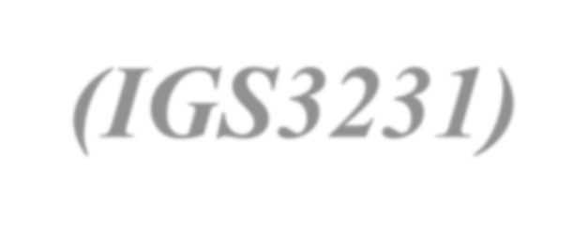




Smart Mobility Engineering Lab
(IGS3231)
Week 2
ISE Department Prof. Mehdi Pirahandeh
School of Global Convergence Studies

Slide 2

Content
Review the syllabus again!
Introduction to Smart Mobility Engineering Lab
Q & A
VMWare Workstation Player Setup
Configuring Ubuntu Virtual Machine
ROS Installation
Activity Session ( OS & ROS 2 Test)
School of Global Convergence Studies
2

Slide 3
Introduction
This course consists of multiple guided tutorials and lab sessions with increasing difficulty levels when working with an autonomous robot and machine learning.
You learn how to set up such a TurtleBot3 from scratch using ROS/ROS2, how to interface the individual sensors and actuators, and finally, how to implement the practical projects.
This course provides students with hands-on lab experience applying Ai and robot programming techniques for implementing the final autonomous robot projects.

Slide 4
Course Goals
By participating in this course attendees will learn how to:
  Practice ROS/ROS2 python/C++ client library: Creating your own ROS/2 C++/Python programs
  Practice the recent simulating tool with ROS: RVIZ, RQT, Gazebo
simulator
  Familiarize the student with the recent machine learning project with ROS/ROS2
  Familiarize the student with the recent Autonomous Vehicle project with
ROS/ROS2

Slide 5
Course Oulines
This course structure is outlined as follows,
  I will notify the detailed class information in GitHub Repository, I-class system, and dedicated Kakao Group.
  The student will present their projects and I will provide them with
multiple feedback.
  Blended Lecture and practice will be provided for students using a mix of offline classes, video content and online Zoom sessions.
  There will be multiple tutoring sessions for helping students.

Slide 6
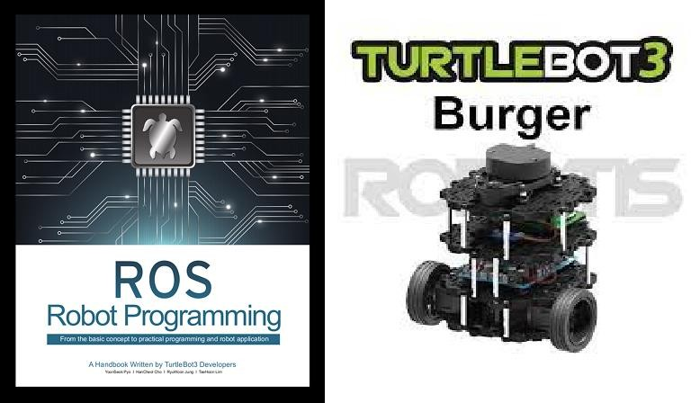
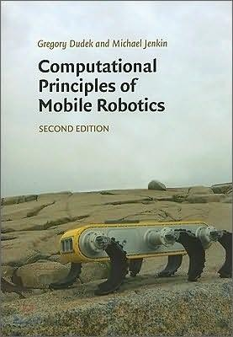
Books

Slide 7
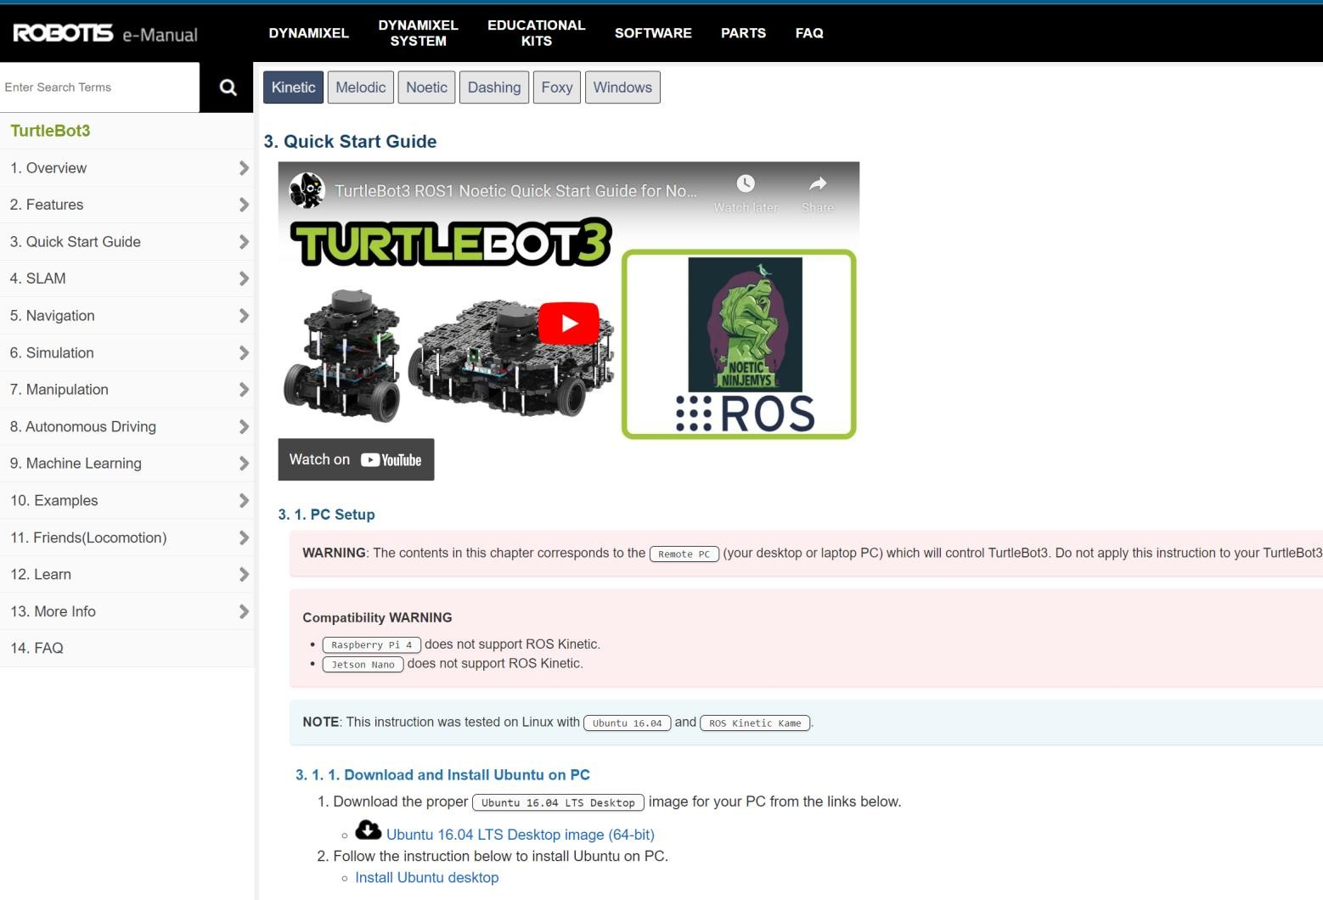


Introduction to Course
https://emanual.robotis.com/docs/en/platform/turtlebot3/quick-start

Slide 8
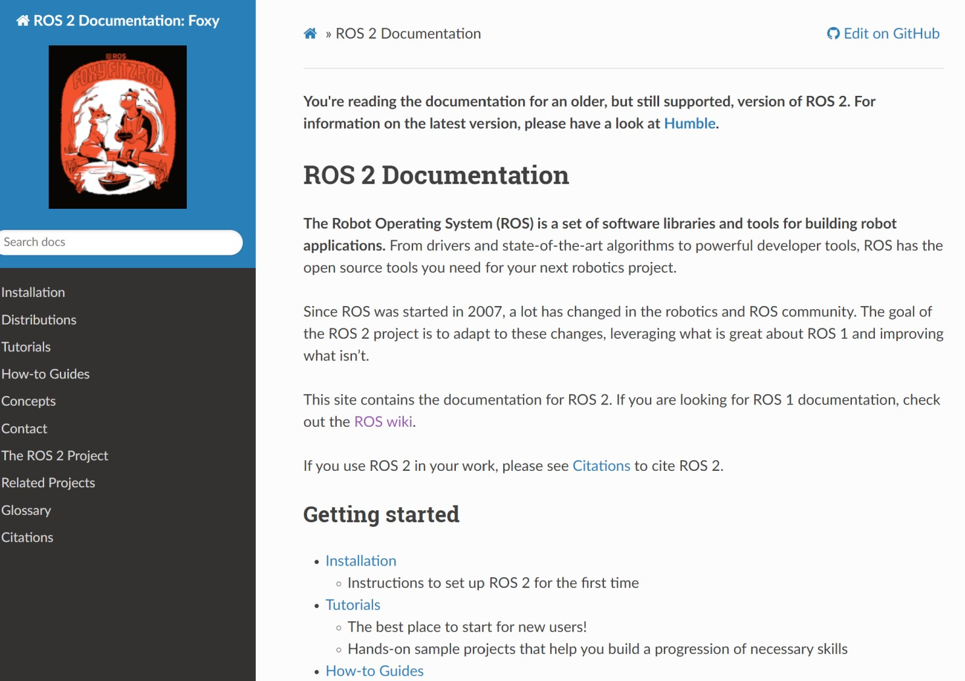
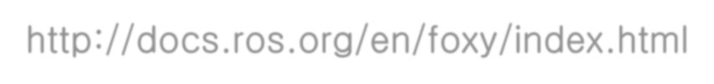
Introduction to Course
http://docs.ros.org/en/foxy/index.html

Slide 9
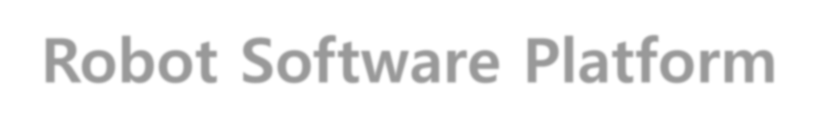
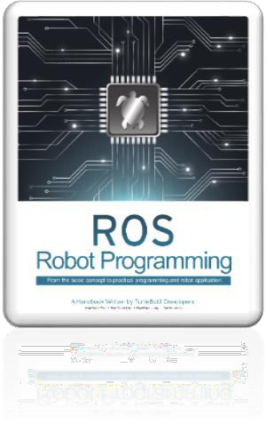

Robot Software Platform
9

Slide 10
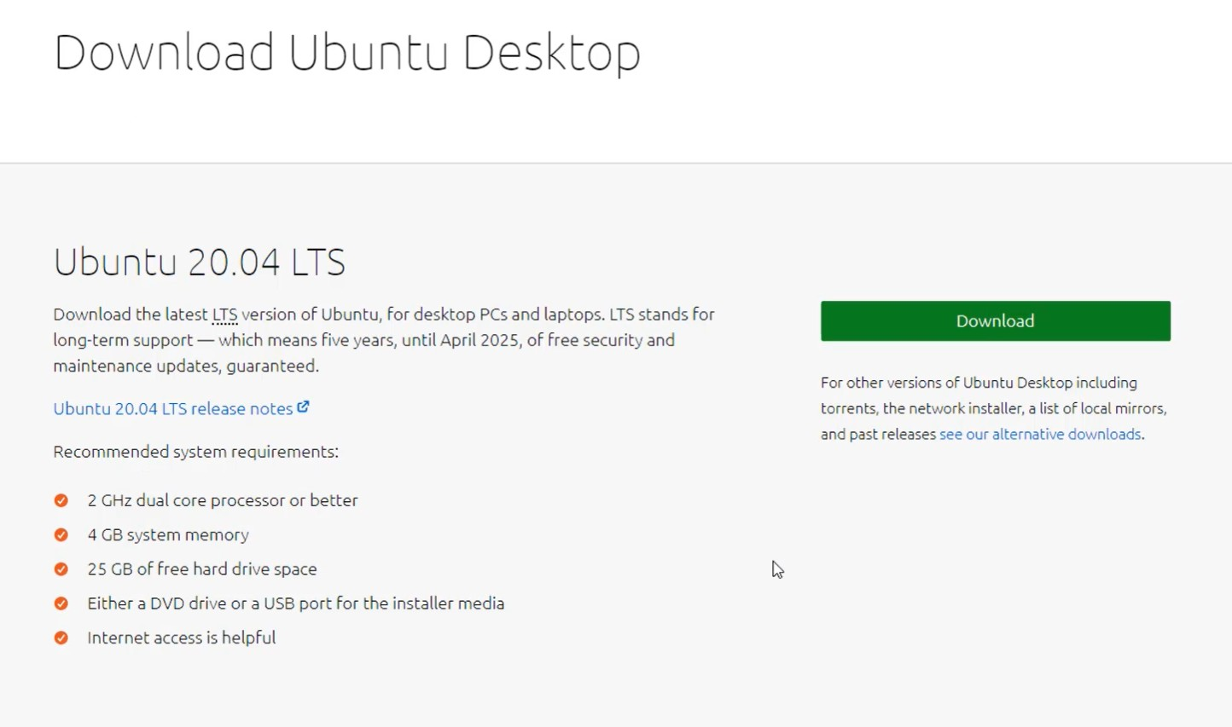
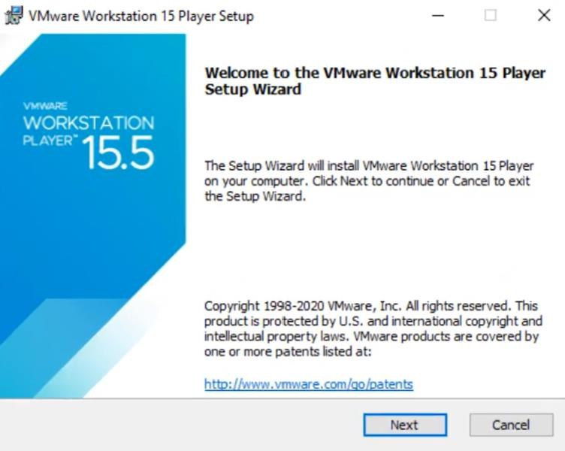
VMWare Workstation Player Setup
10

Slide 11
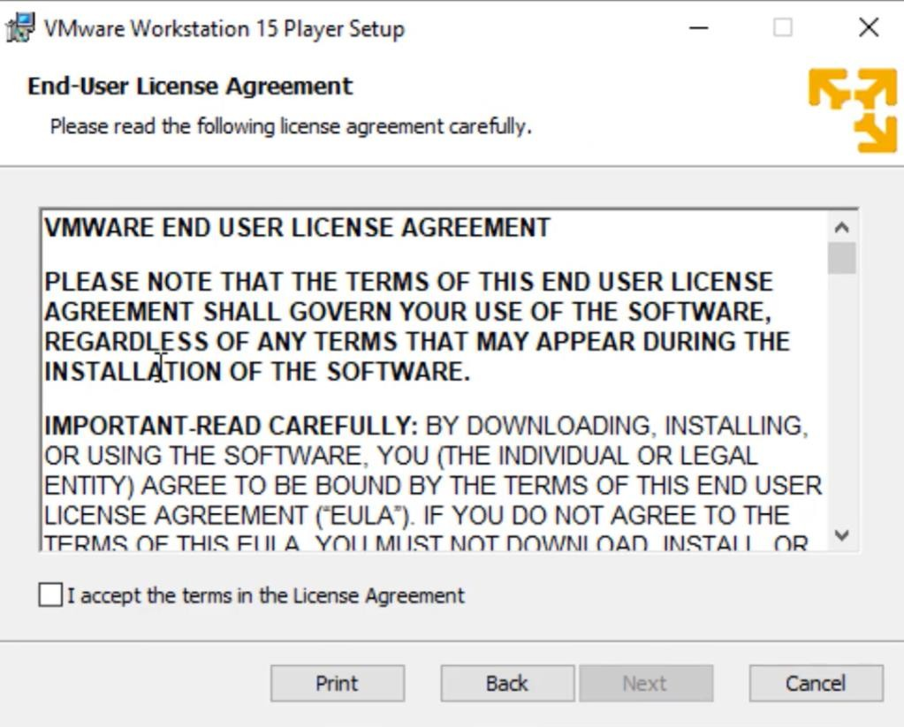
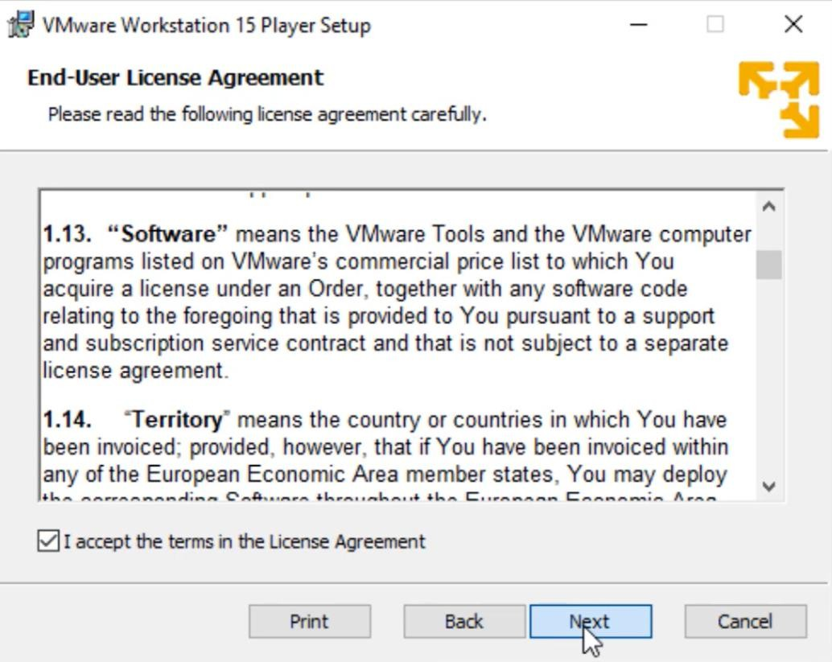
VMWare Workstation Player Setup
11

Slide 12
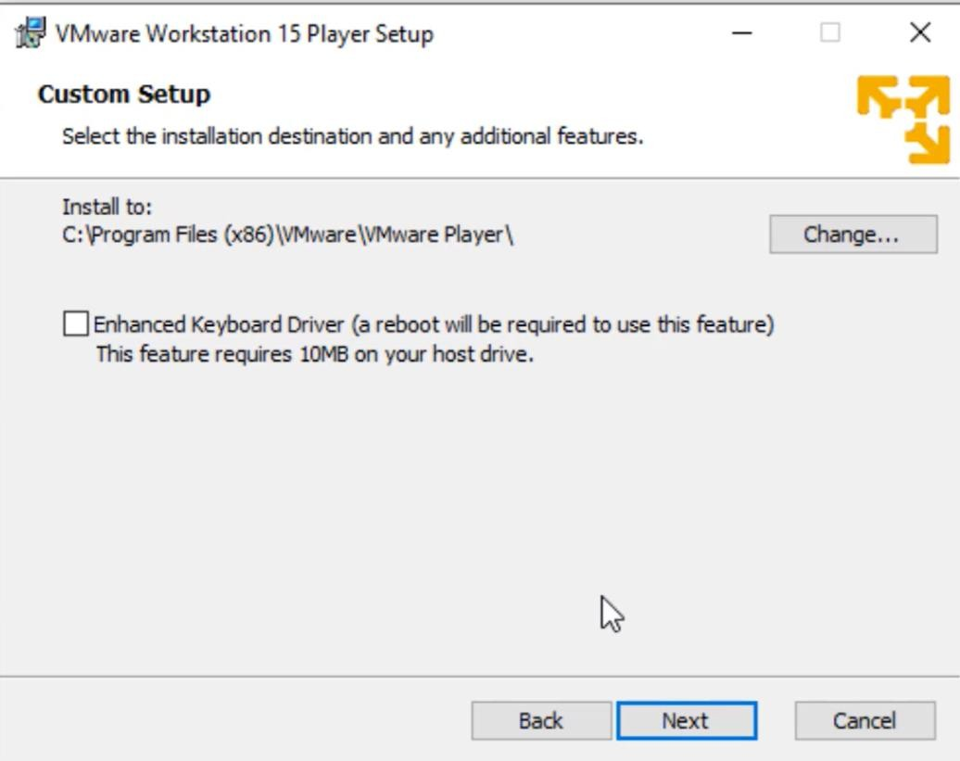
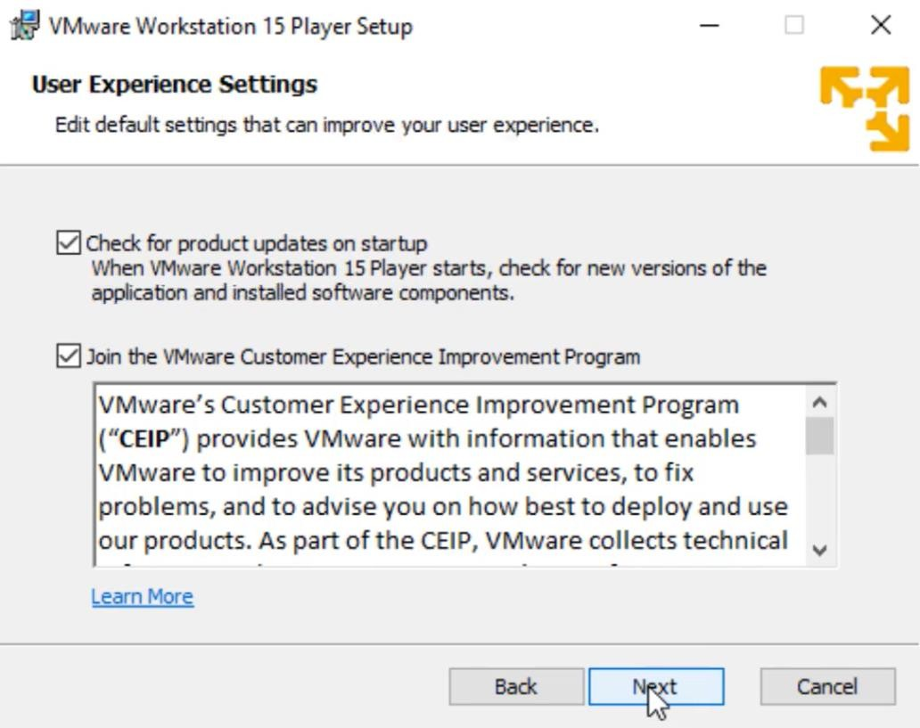
VMWare Workstation Player Setup
12

Slide 13
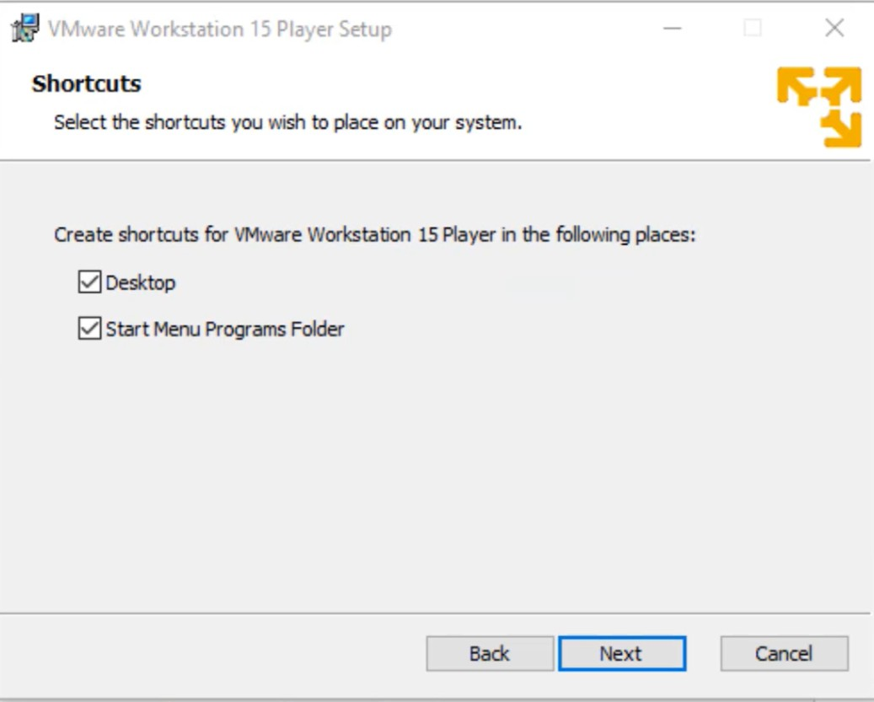
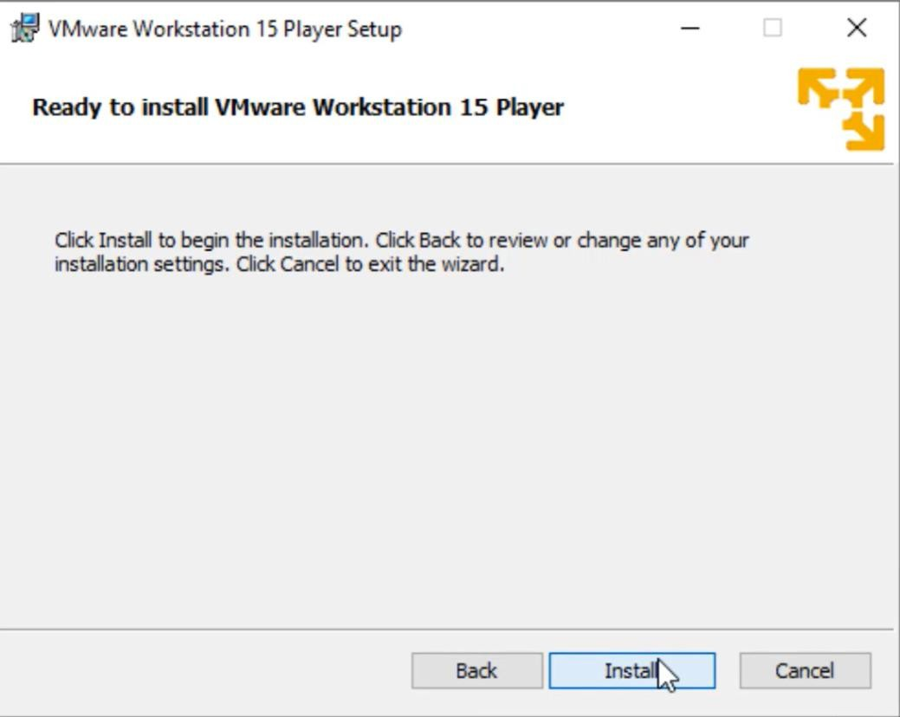
VMWare Workstation Player Setup
13

Slide 14
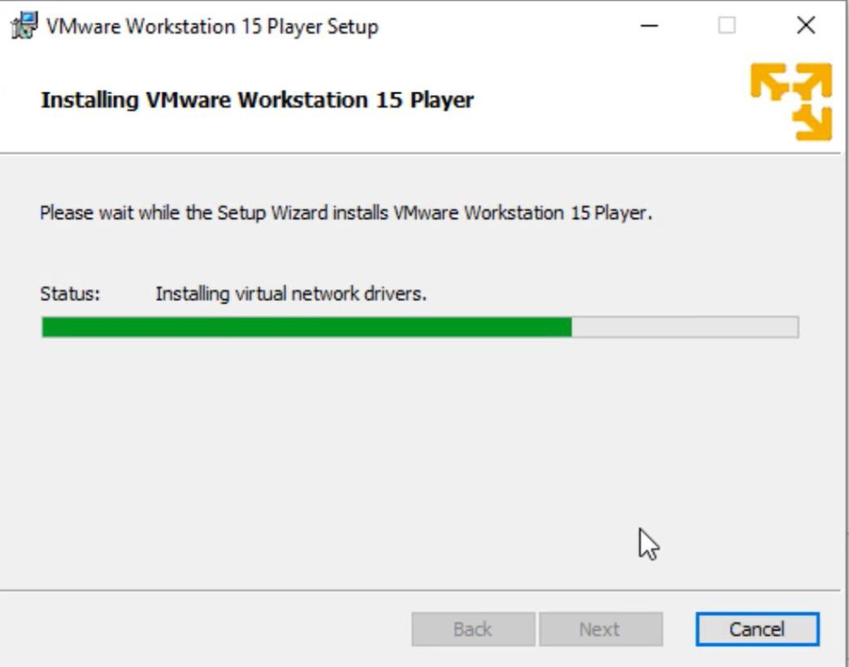
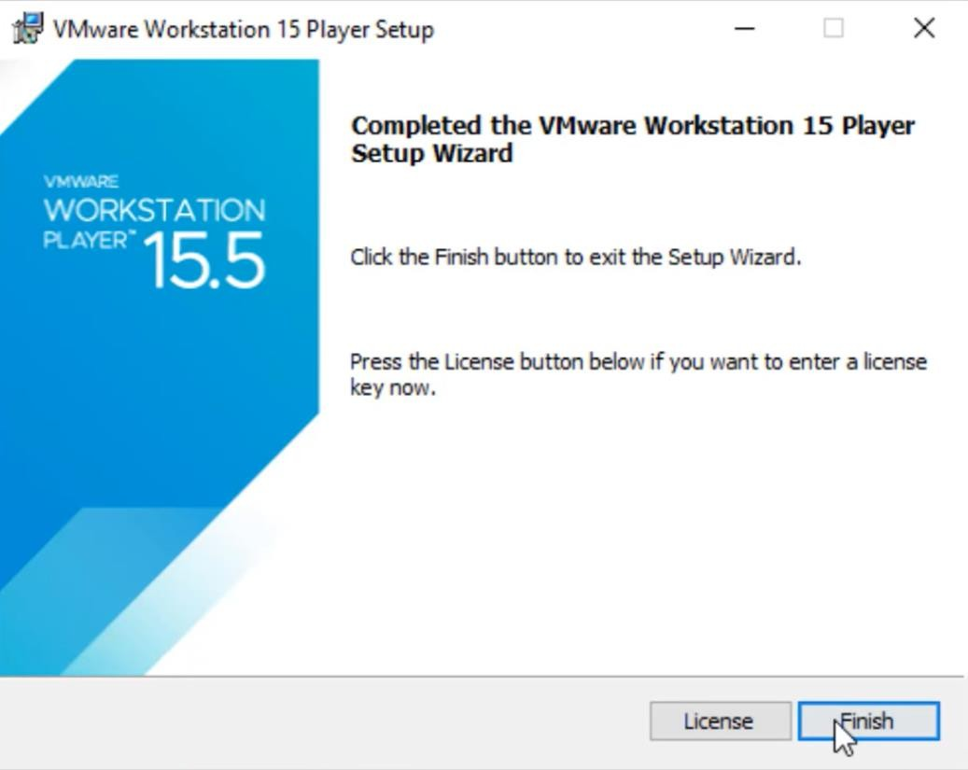
VMWare Workstation Player Setup
14

Slide 15
Configuring Ubuntu Virtual Machine
15

Slide 16
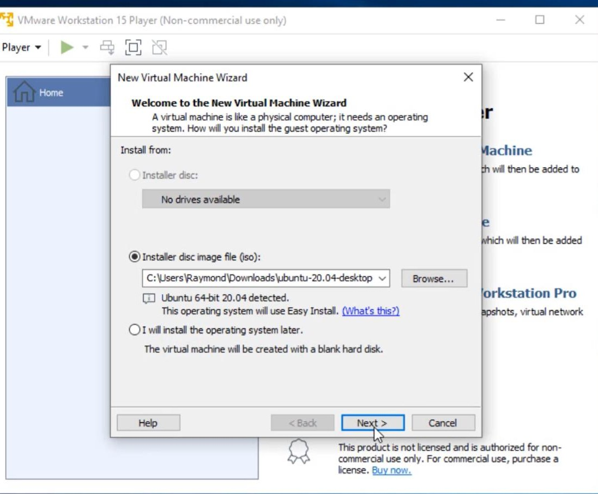
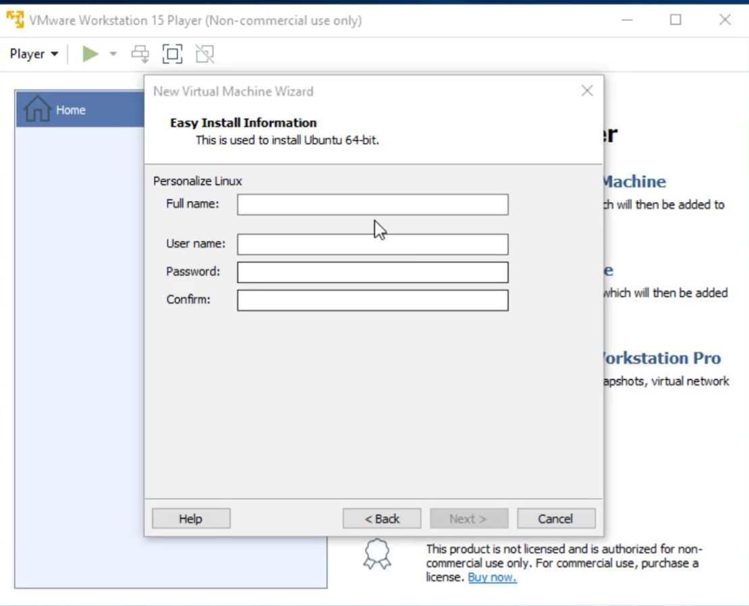
Configuring Ubuntu Virtual Machine

Slide 17
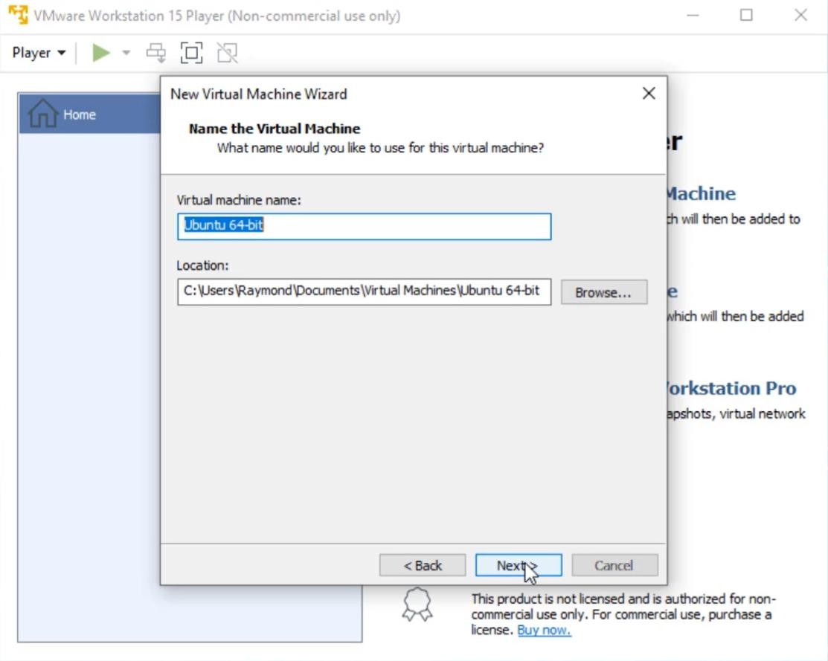
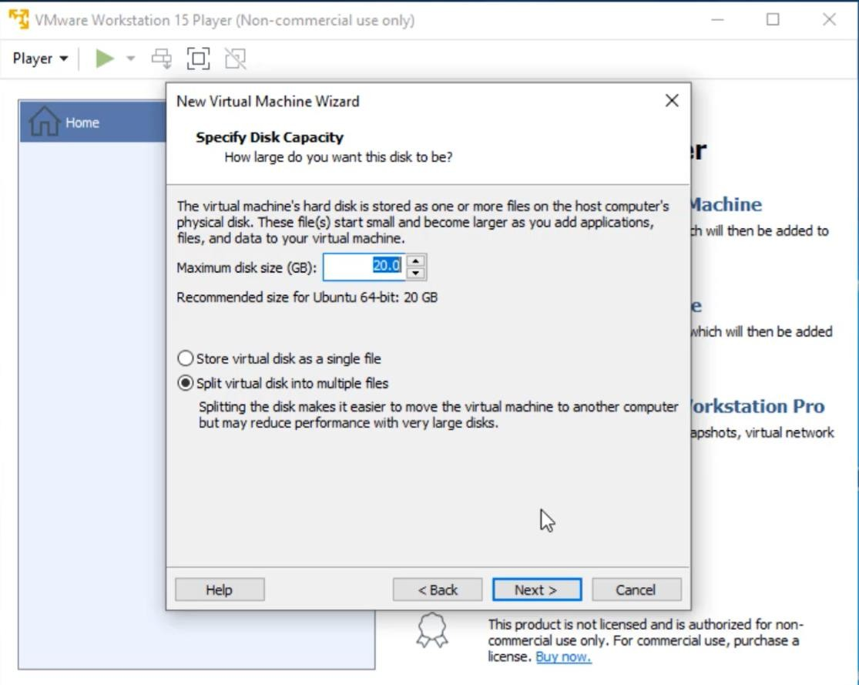
Configuring Ubuntu Virtual Machine

Slide 18
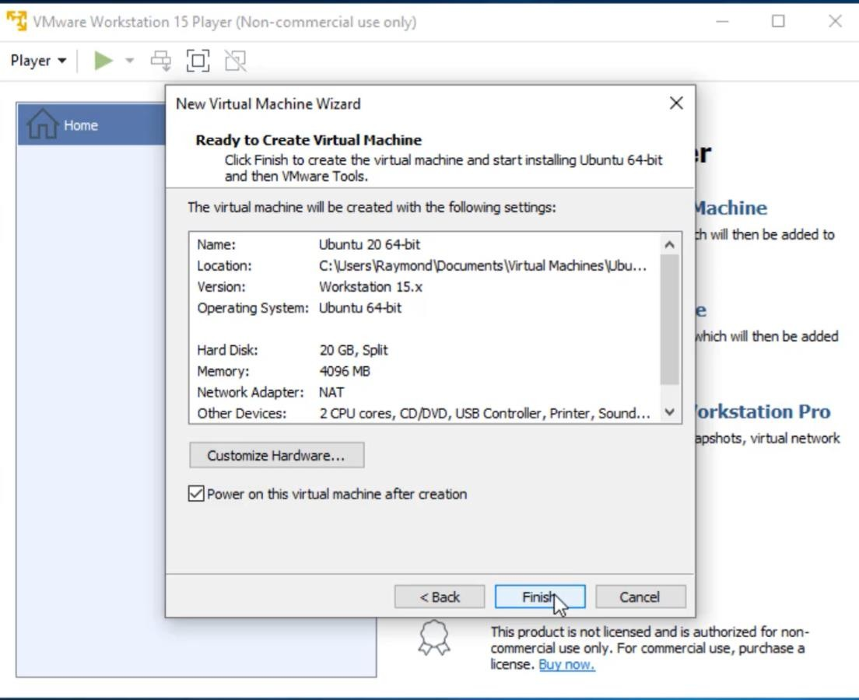
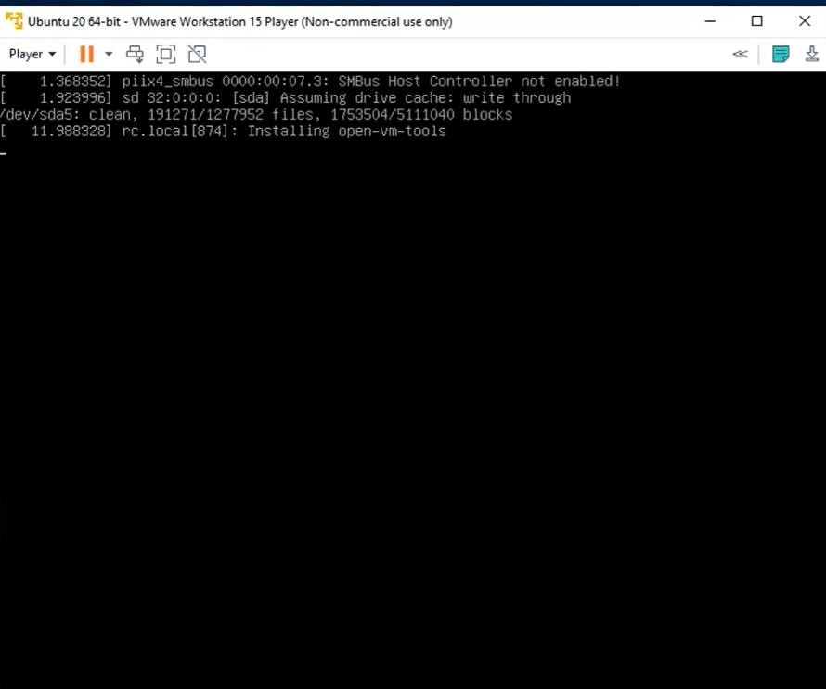
Configuring Ubuntu Virtual Machine

Slide 19
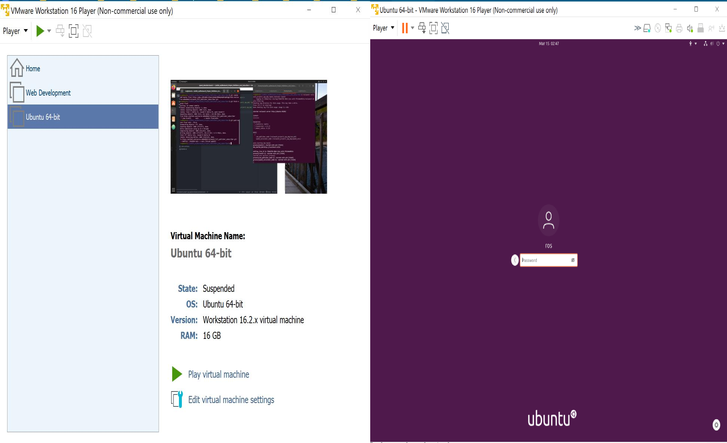
Configuring Ubuntu Virtual Machine

Slide 20
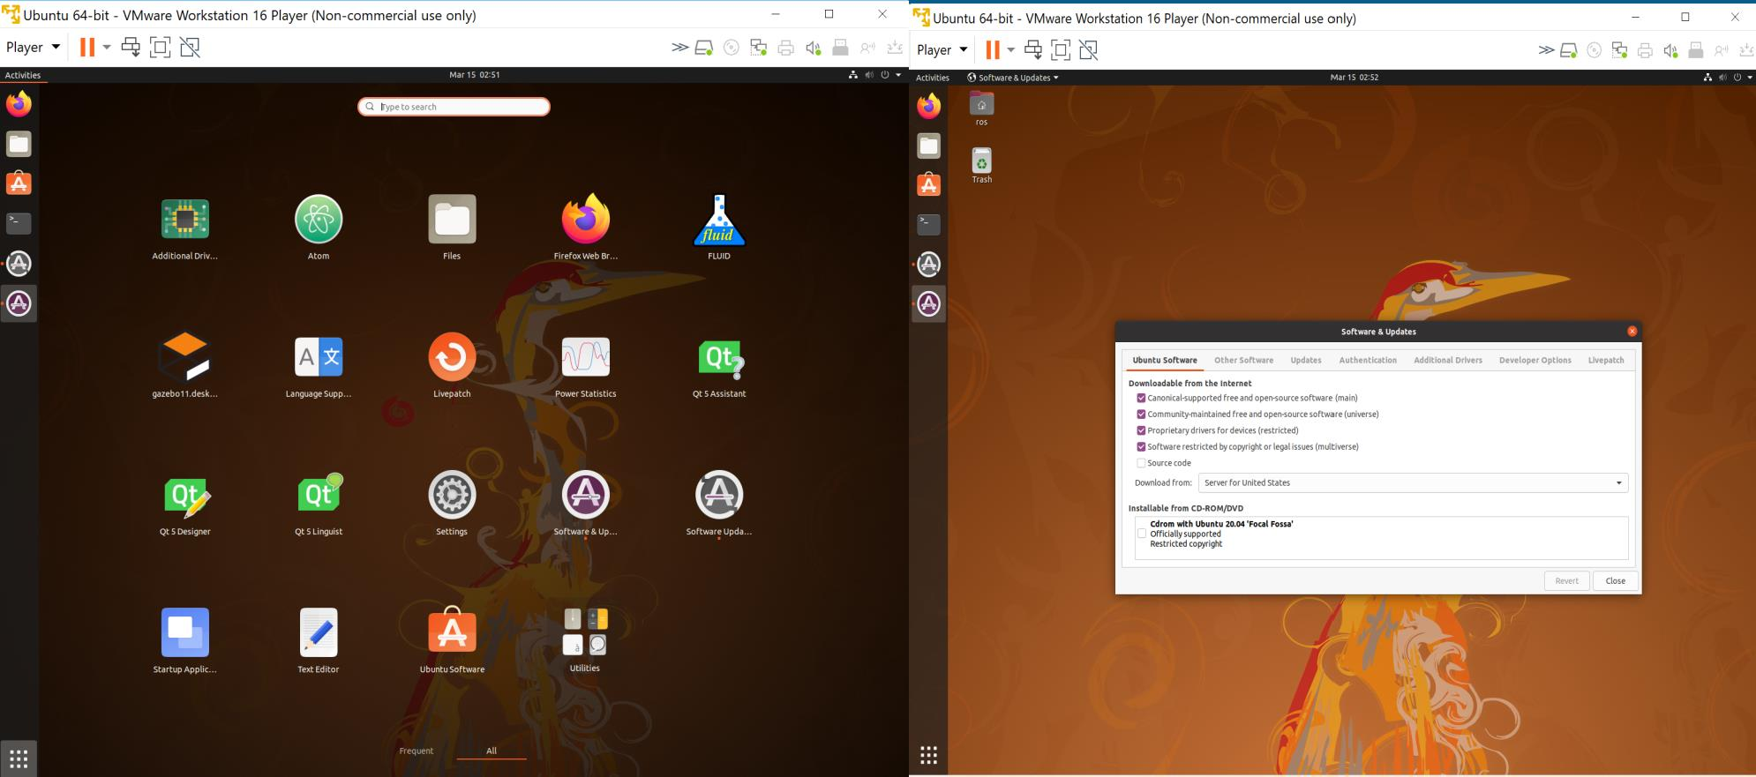
Configuring Ubuntu Virtual Machine

Slide 21
Activity Session
Activity Session
( OS & ROS 2 Test)

Slide 22
Installation
ROS 2
22

Slide 23
ROS Installation
Set Locale
Make sure you have a locale which supports UTF-8.
locale # check for UTF-8
sudo apt update && sudo apt install locales
sudo locale-gen en_US en_US.UTF-8
sudo update-locale LC_ALL=en_US.UTF-8 LANG=en_US.UTF-8
export LANG=en_US.UTF-8
locale # verify settings
2. Setup Sources
You will need to add the ROS 2 apt repository to your system. First, make sure that the Ubuntu Universe repository is enabled by checking the output of this command.
apt-cache policy | grep universe
This should output a line like the one below:

Slide 24
ROS Installation
If you don’t see an output line like the one above, then enable the Universe repository with these instructions.
sudo apt install software-properties-common
sudo add-apt-repository universe
Now add the ROS 2 apt repository to your system. First authorize our GPG key with apt.
sudo apt update && sudo apt install curl gnupg lsb-release
sudo curl -sSL https://raw.githubusercontent.com/ros/rosdistro/master/ros.key -o /usr/share/keyrings/ros-archive-keyring.gpg
Then add the repository to your sources list.
echo "deb [arch=$(dpkg --print-architecture) signed-by=/usr/share/keyrings/ros-archive-keyring.gpg] http://packages.ros.org/ros2/ubuntu $(source /etc/os-release && echo $UBUNTU_CODENAME) main" | sudo tee /etc/apt/sources.list.d/ros2.list > /dev/null

Slide 25
ROS Installation
3. Installation
Update your apt repository caches after setting up the repositories.
sudo apt update –y
sudo apt upgrade
4. Desktop-Full Install: (Recommended) :
Everything in Desktop plus 2D/3D simulators and 2D/3D perception packages
sudo apt install ros-humble-desktop
sudo apt install ros-humble-ros-base
5. Ubuntu Environment Setup
You must source this script in every bash terminal you use ROS in.
source /opt/ros/humble/setup.bash
It can be convenient to automatically source this script every time a new shell is
launched. These commands will do that for you.
echo "source /opt/ros/humble/setup.bash" >> ~/.bashrc source ~/.bashrc

Slide 26
ROS Installation
6. Testing ROS Installation
If you installed ros-humble-desktop above, you can try some examples.
In one terminal, source the setup file and then run a C++ talker:
source /opt/ros/humble/setup.bash
ros2 run demo_nodes_cpp talker
In another terminal source the setup file and then run a Python listener:
source /opt/ros/humble/setup.bash
ros2 run demo_nodes_py listener

Slide 27

Brief break (if on schedule)
Q&A?
Prof. Mehdi Pirahandeh
E-mail : mehdi at inha dot ac dot kr

